Slide 1
Determination of Oxygen Local Bonding in Lithium Transition Metal Oxides using Computed XANES: A Machine Learning Approach
Liang Li
09/12/2018 subgroup meeting

Slide 2
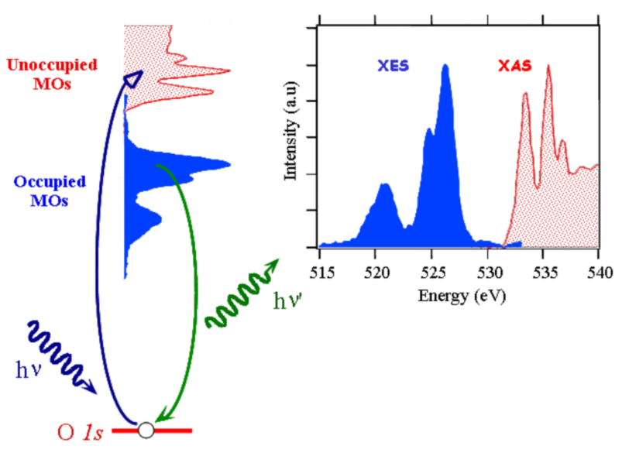
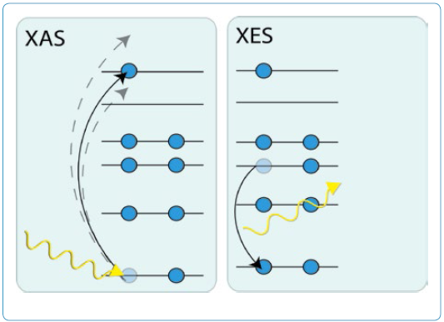
X-Ray Absorption Spectroscopy
A great tool to probe local geometries/electronic states
Advanced Photon Source @ Argonne
C.L. Dong et al. 2007 SPIE Newsroom
http://www.laboratory-journal.com/
X-Ray Absorption Spectroscopy (XAS): probe the unoccupied states that are filled by excited electrons

Slide 3
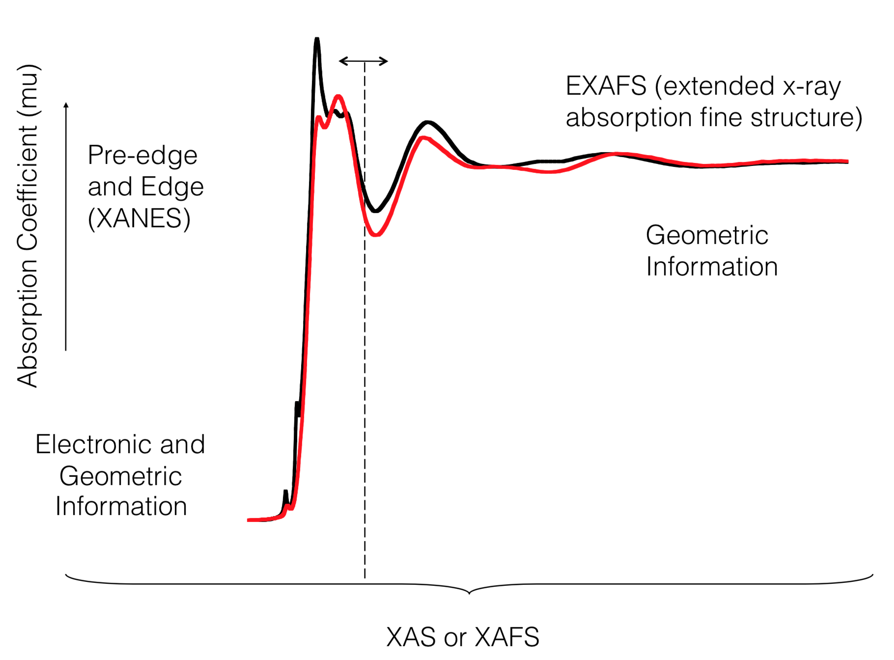
X-ray Absorption Near-Edge Structure
element-specific, sensitive to chemical information
image courtesy: R. Sarangi

Slide 4
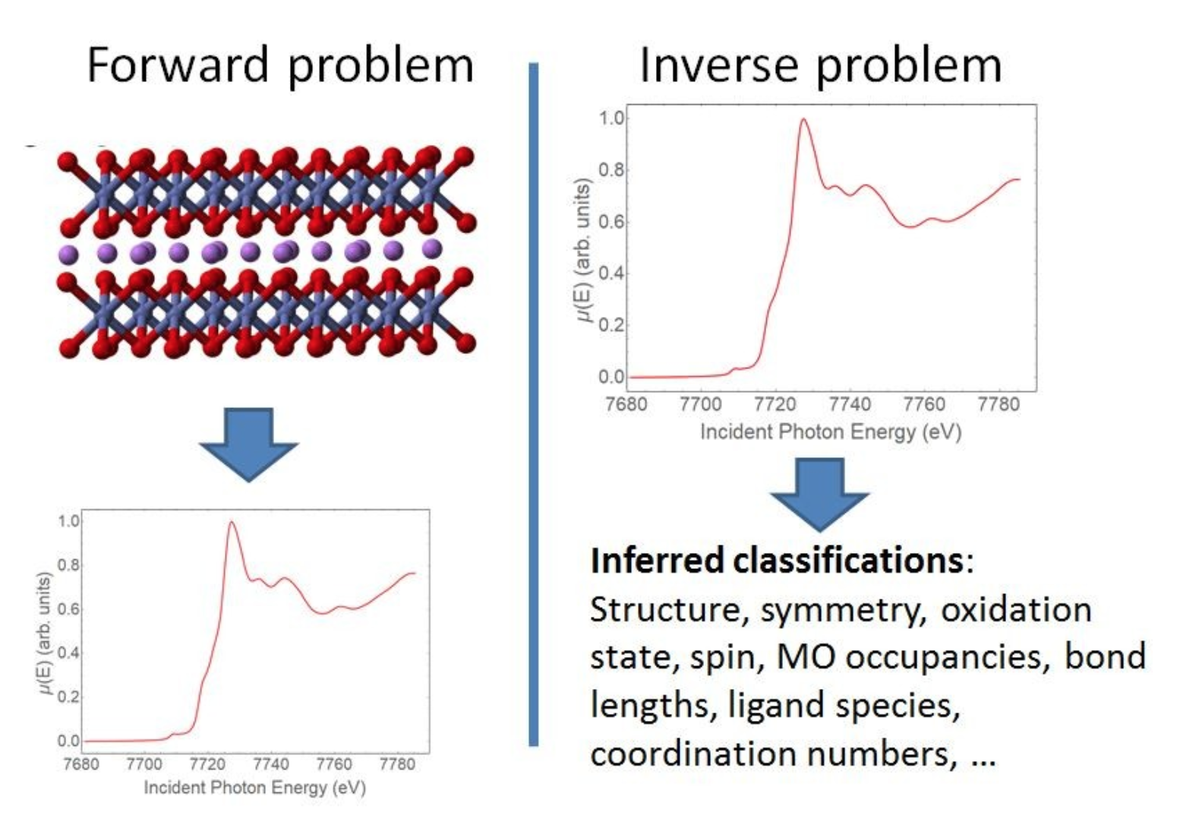
Difficulty of Inverse Problem
Real-space multi-scattering, BSE, excited core-hole…
Machine learning
Gerald Seidler, Machine Learning vs. XAFS Interpretation

Slide 5
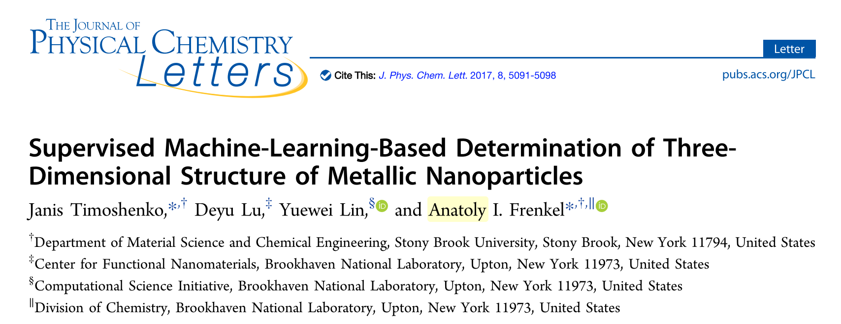
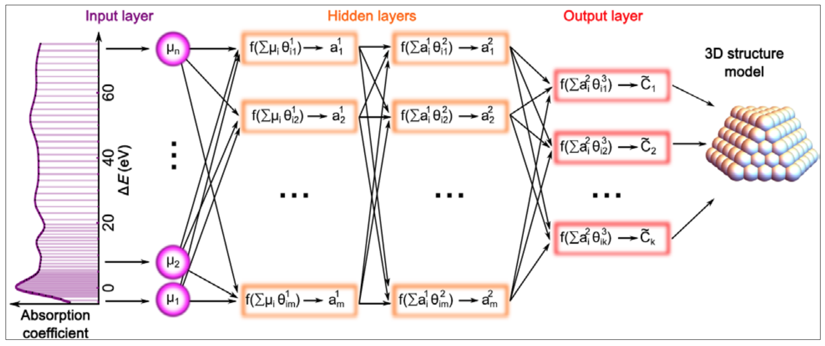
Using ML to Determine Nanoparticle Structures
129 nodes in input layer
Two hidden layers, 339 – 387 nodes in each
Hyperbolic tangent function as activation function
J. Timoshenko, J. Phys. Chem. Lett. 8, 5091-5098 (2017)

Slide 6
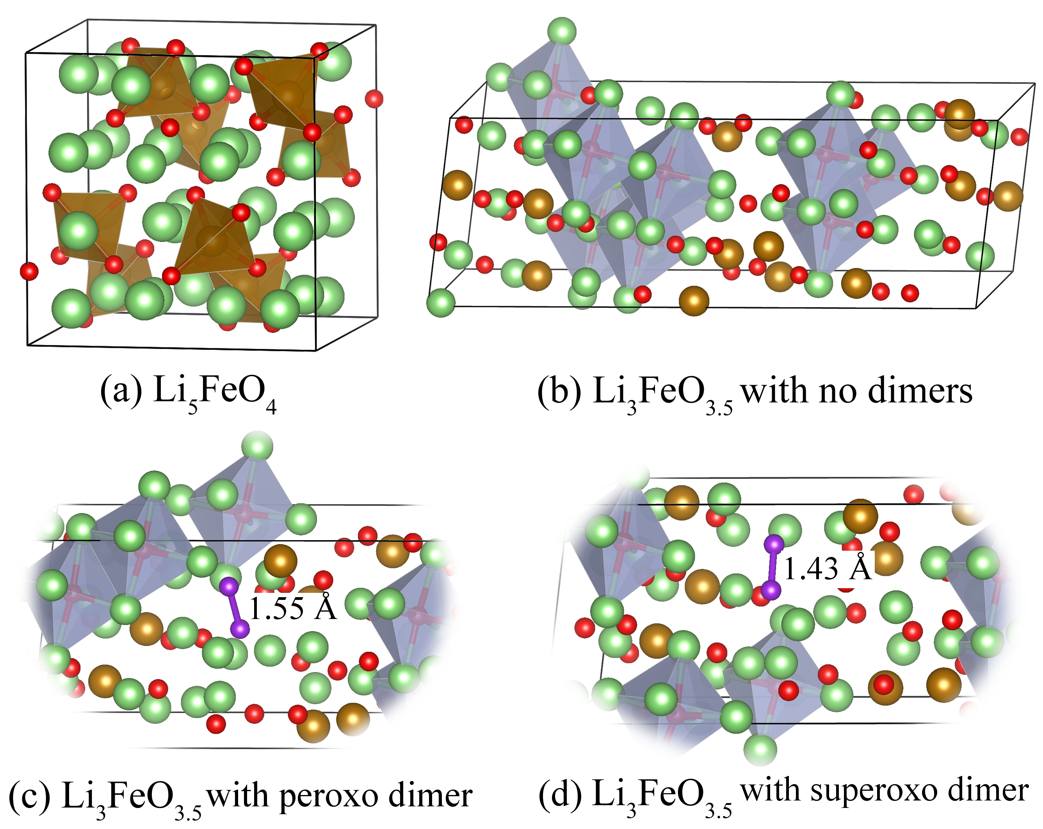

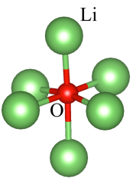
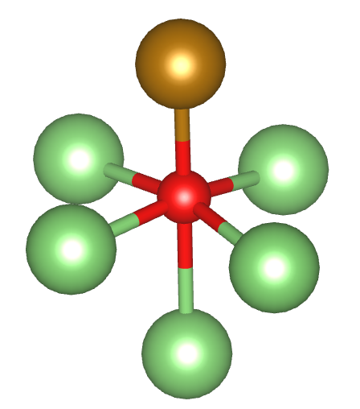
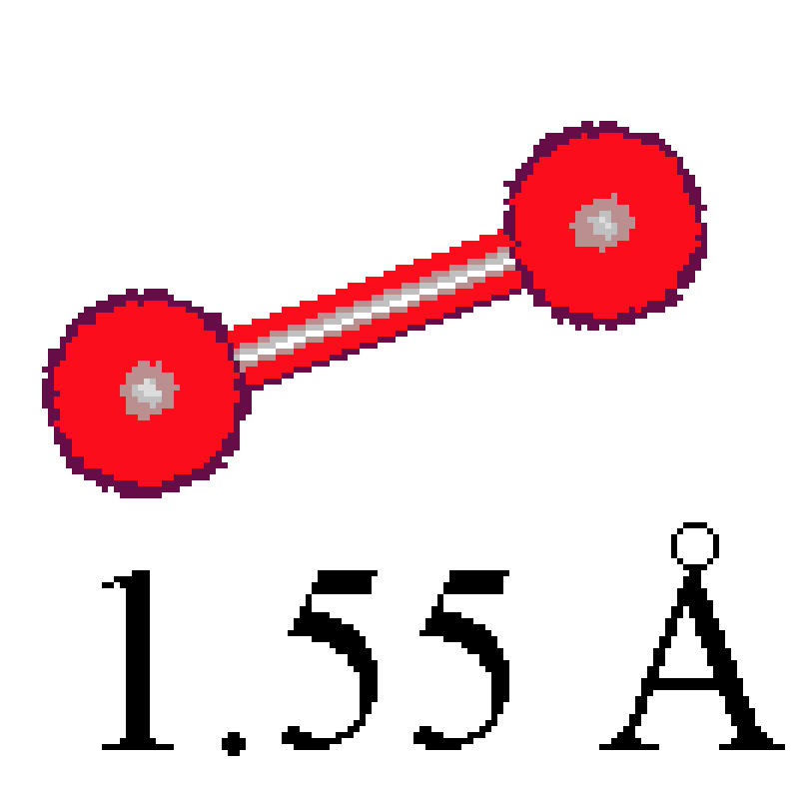
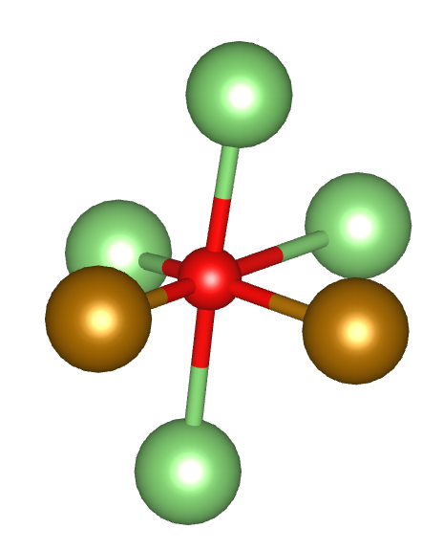
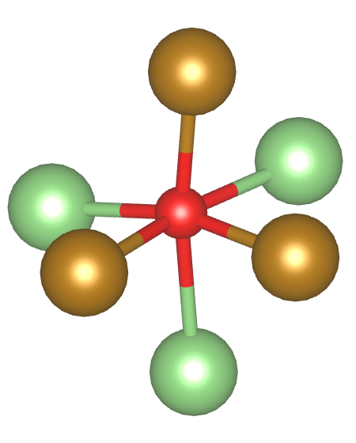
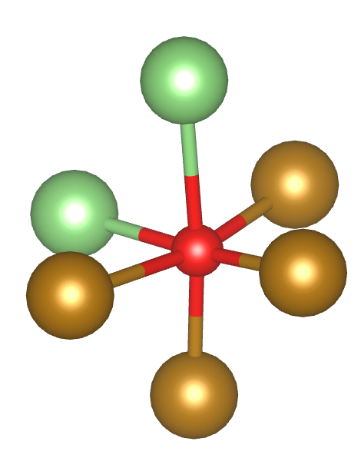
Oxygen Local Environments in Li₃FeO_{3.5}
Li
O
Fe
cutoff radius = 2.6 Å
N_{Fe} = 0
N_{Fe} = 1
AIMD at 15 ps
AIMD at 20 ps
N_{Fe} = 2
N_{Fe} = 3
N_{Fe} = 4
Fe coordination is an indicator of relative Li concentration
Affects oxygen electronic structure and number of electrons for battery capacity

Slide 7
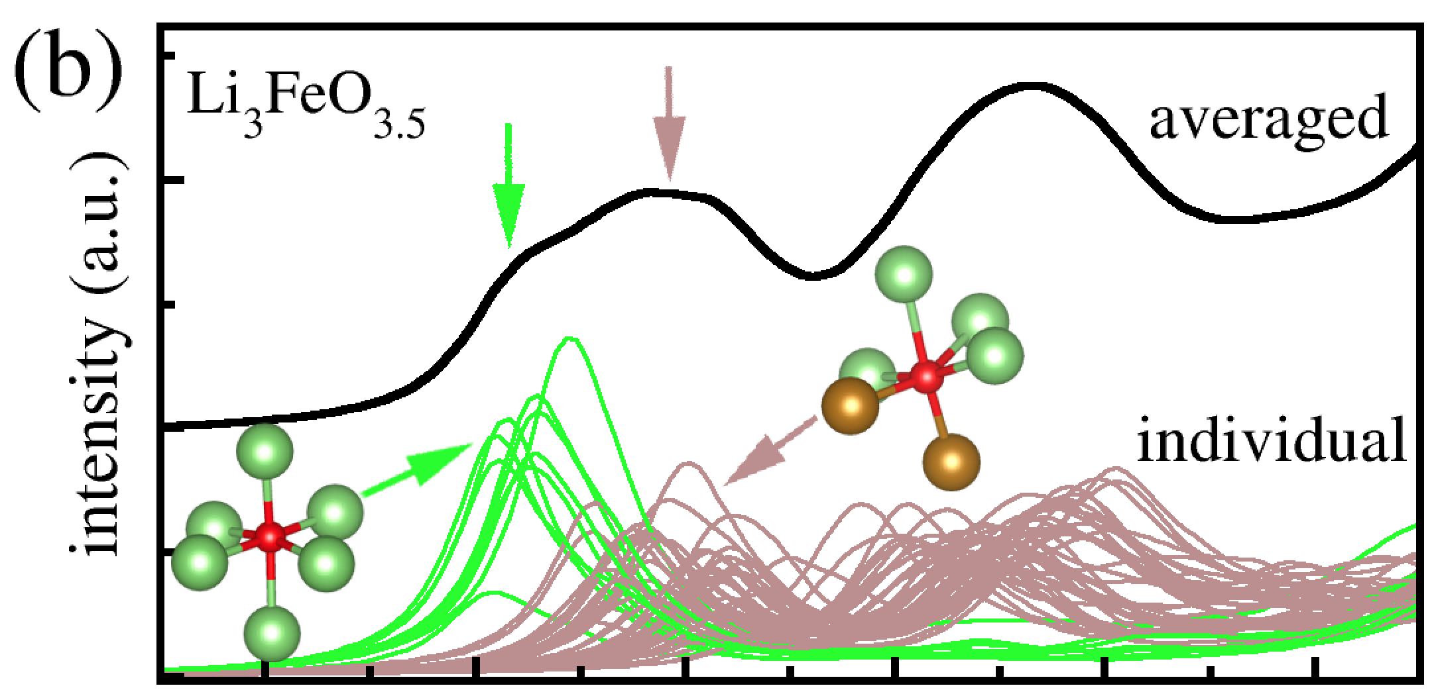
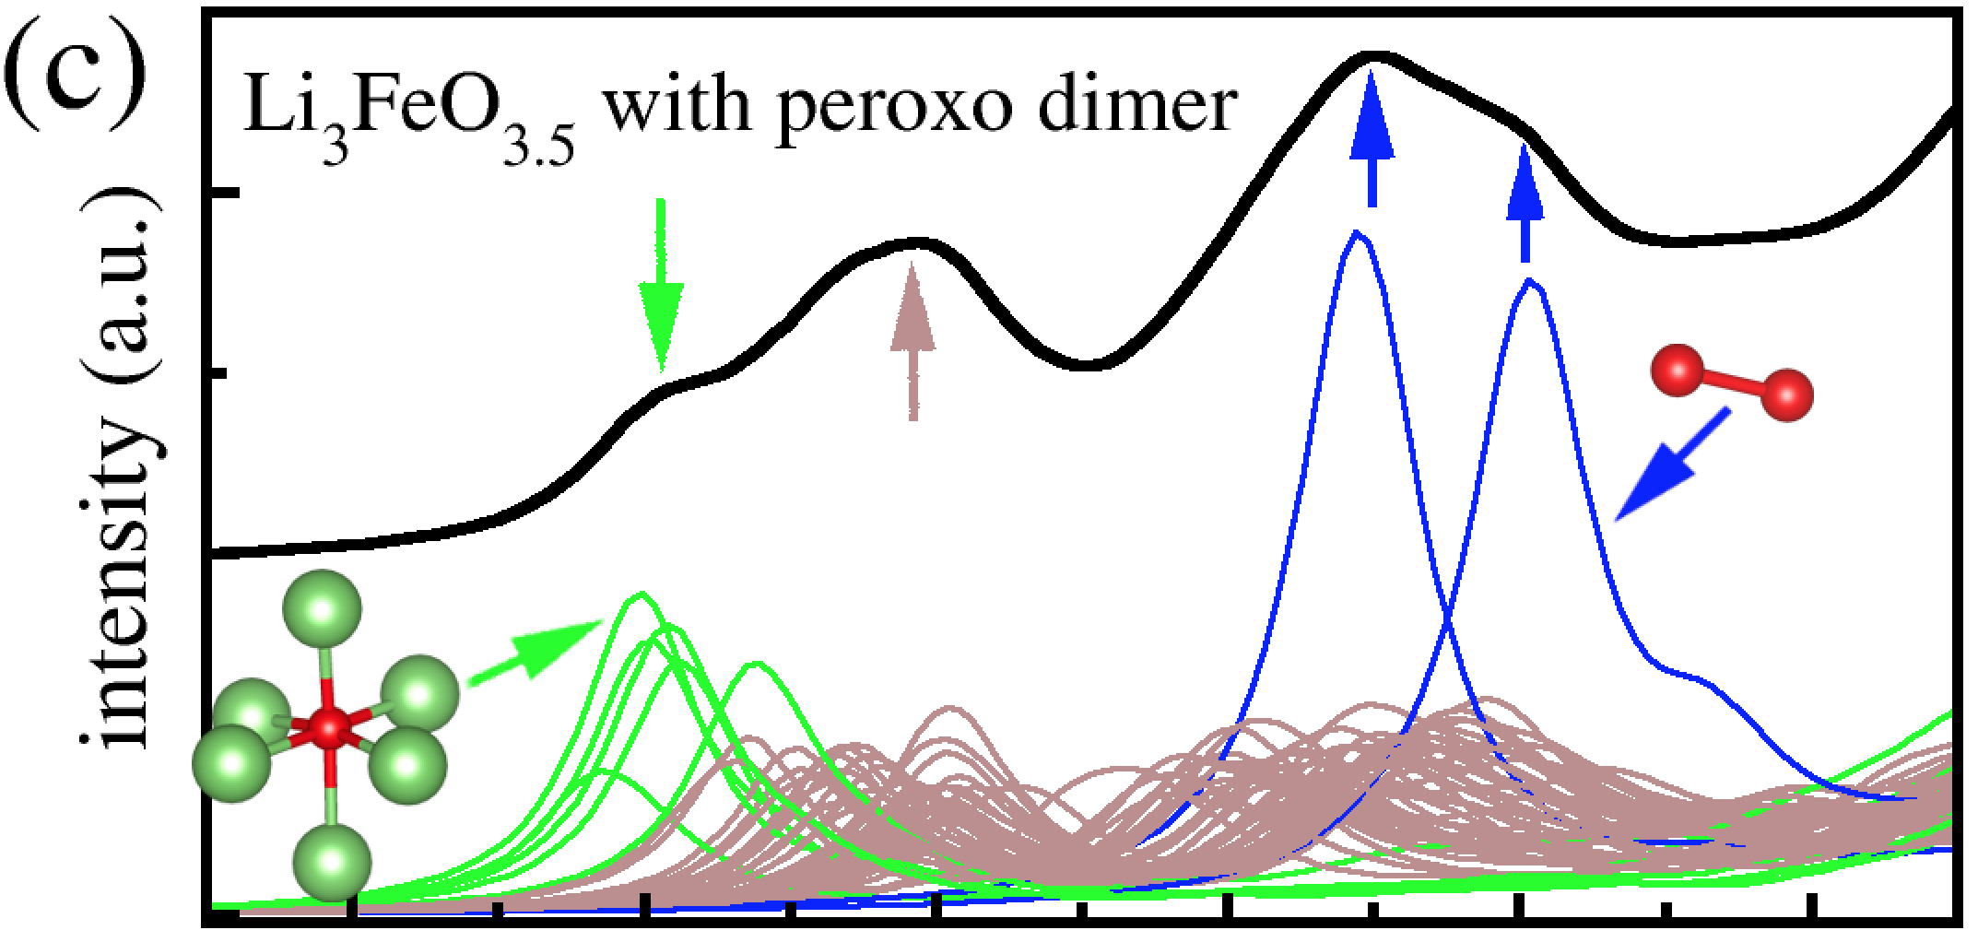
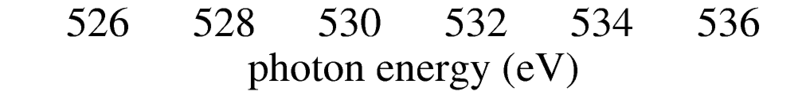
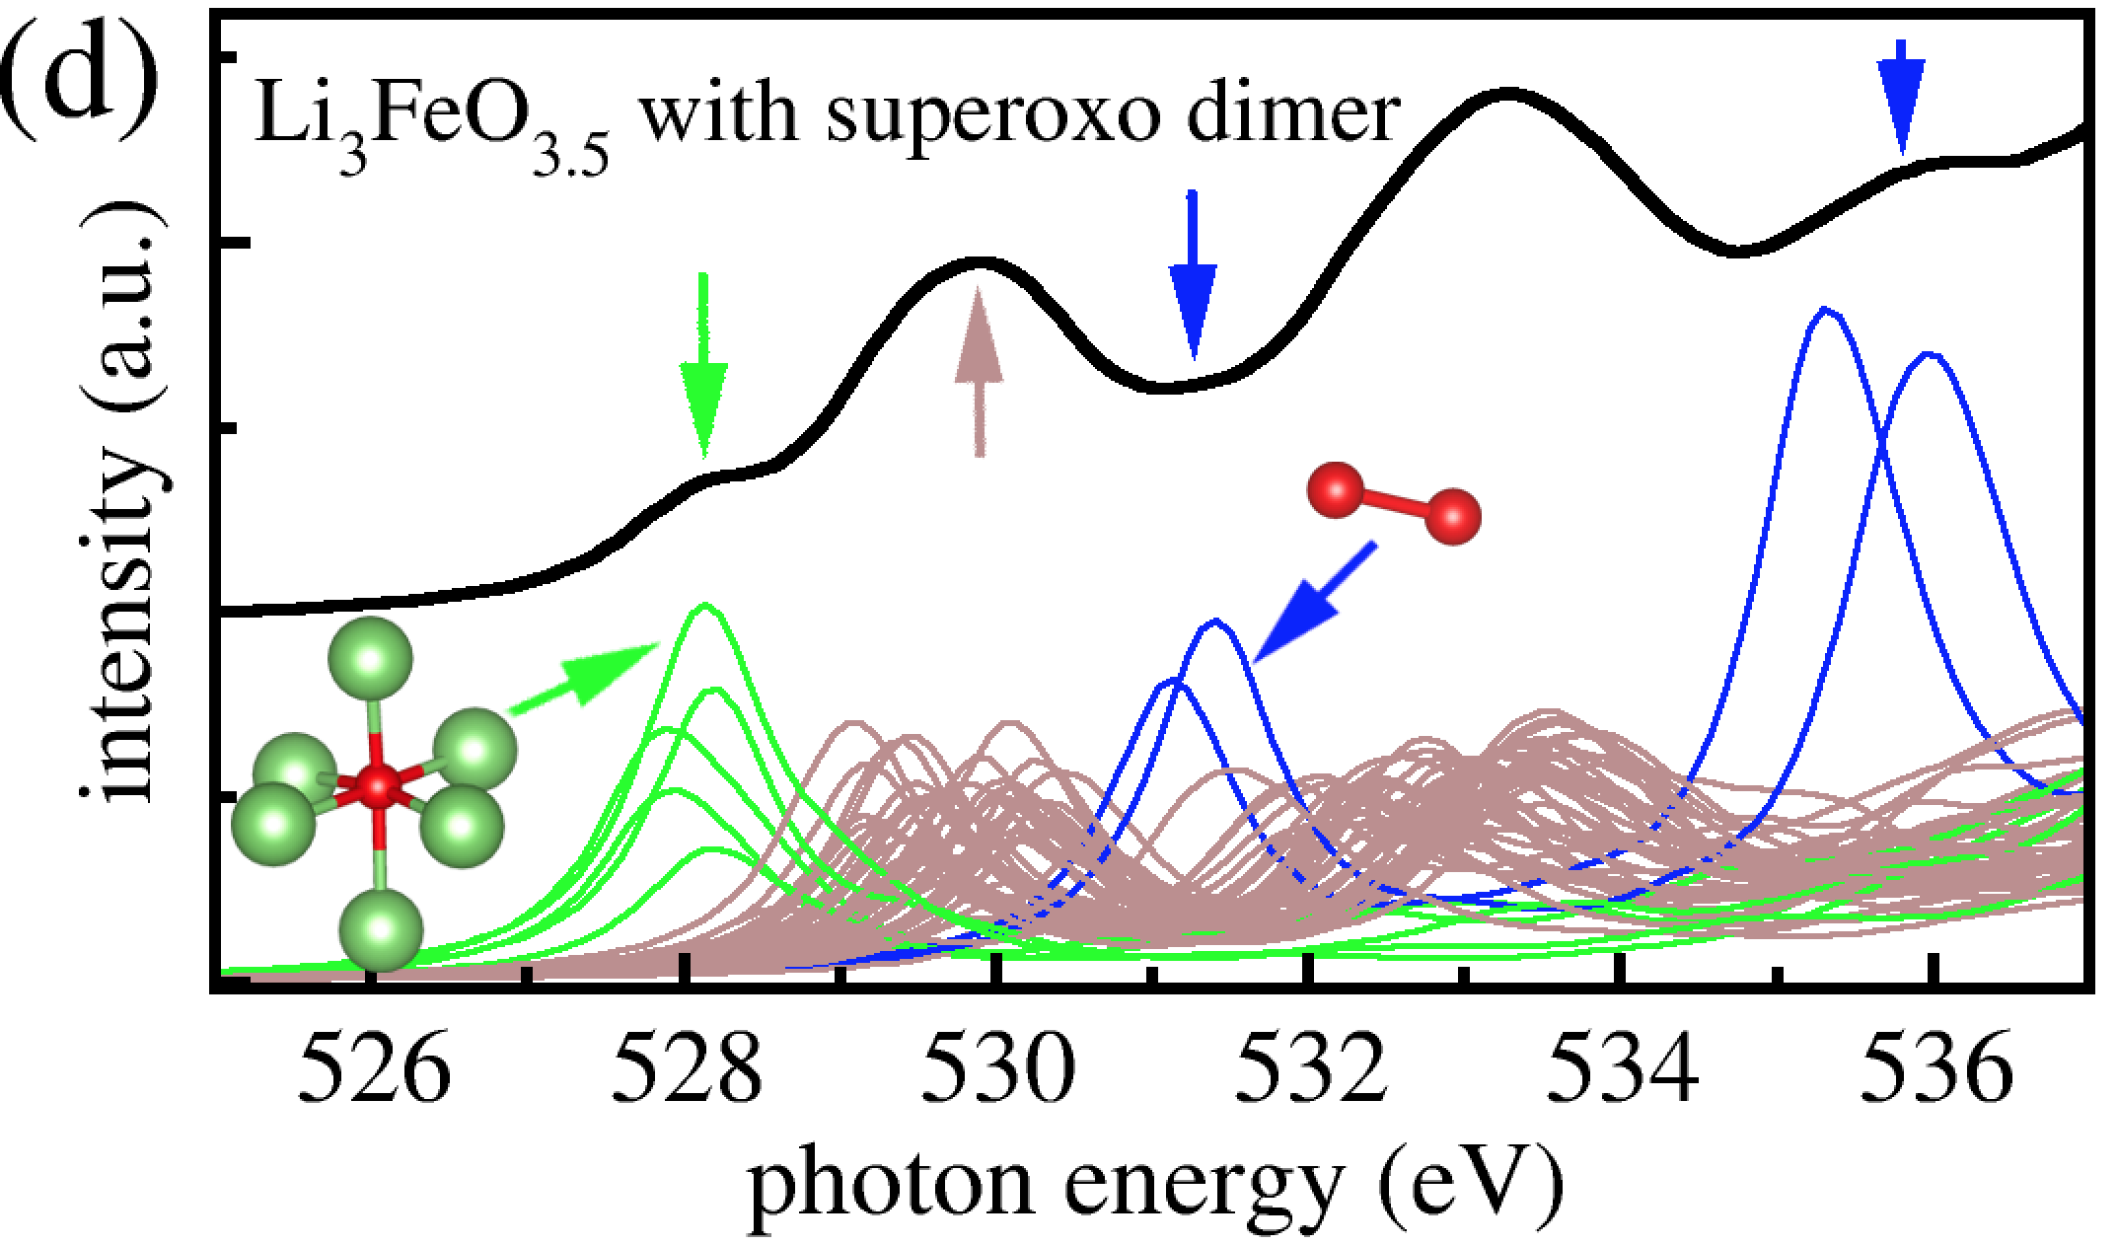
Simulated Oxygen XANES
Li₃FeO_{3.5}
Li₃FeO_{3.5} with peroxo O-O dimer
Li₃FeO_{3.5} with superoxo O-O dimer
Goal: Determine the number of Fe bound to oxygen based on calculated XANES
Multi-class classification problem
Three Li₃FeO_{3.5} structures, 49 oxygen atoms in each
147 examples in total
Intensities in the energy range of 0-14 eV used as input. 170 data points for each spectrum.

Slide 8
Neural Network Architecture (Multi-Class Classification)
hidden layer
input layer
output layer
x₁
x₂
x₃
.
.
.
x₁₆₉
x₁₇₀
N_{Fe} = 0
N_{Fe} = 1
N_{Fe} = 2
N_{Fe} = 3
N_{Fe} = 4
. . .
. . .
(5 x 147)
(170 x 147)

Slide 9
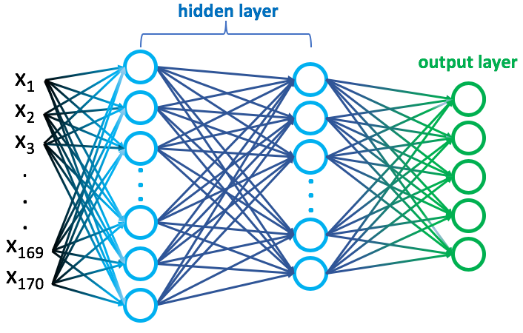
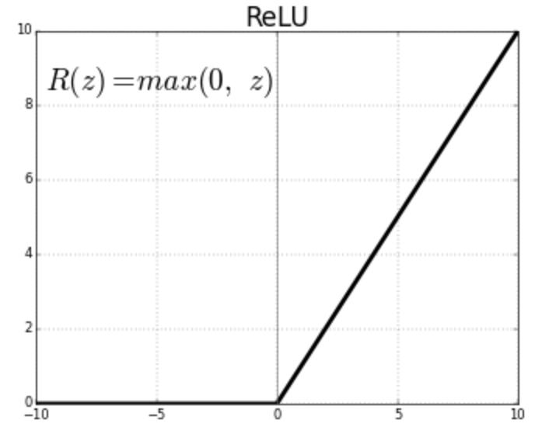
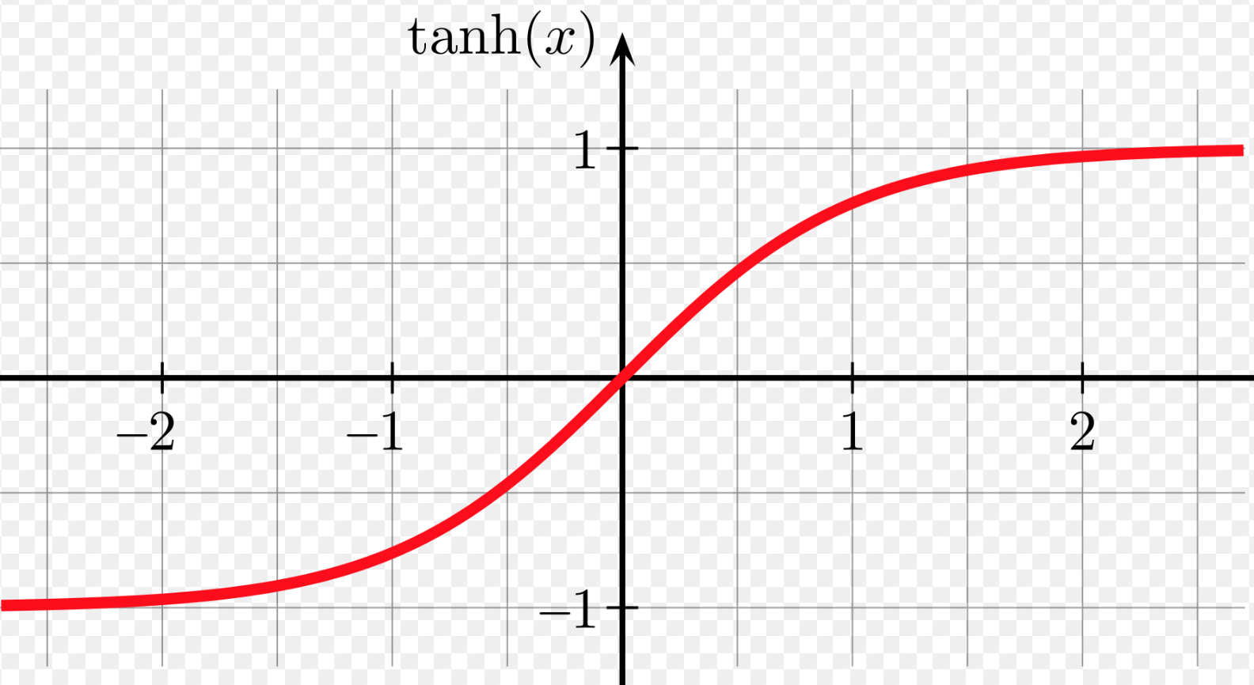
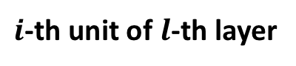
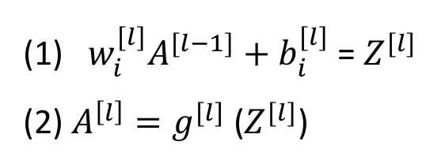
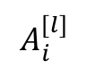
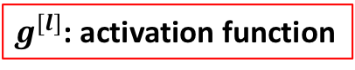
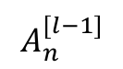
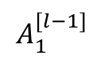
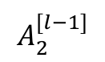
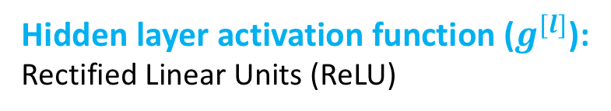
Neural Network Architecture (Multi-Class Classification)
Hidden layer activation function ($g^{[l]}$):
Rectified Linear Units (ReLU)
or hyperbolic tangent function
$i$-th unit of $l$-th layer
$$A_{1}^{[l−1]}$$
(1) $w_{i}^{[l]}A^{[l−1]}+b_{i}^{[l]}$ = $Z^{[l]}$
(2) $A^{\left[l\right]}=g^{[l]}$ ($Z^{[l]}$)
$$A_{i}^{[l]}$$
$$A_{2}^{[l−1]}$$
$$A_{n}^{[l−1]}$$
$g^{[l]}$: activation function

Slide 10
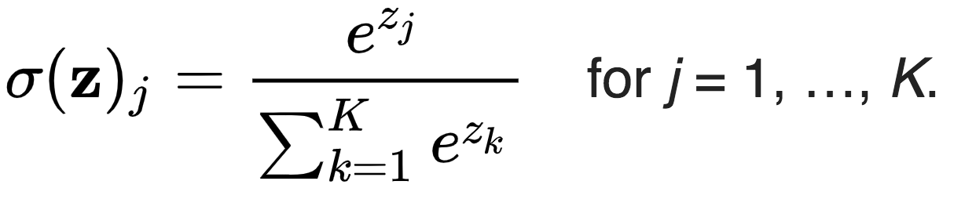
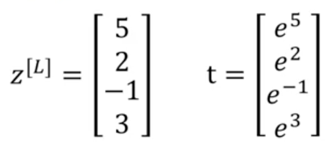
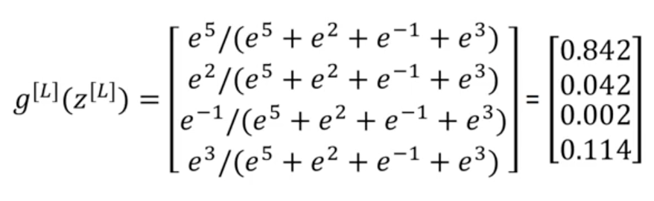
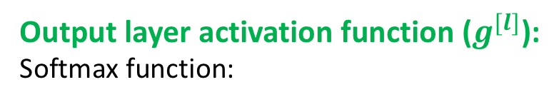
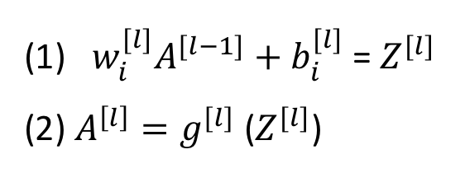
Neural Network Architecture (Multi-Class Classification)
Output layer activation function ($g^{[l]}$):
Softmax function:
e.g.
(1) $w_{i}^{[l]}A^{[l−1]}+b_{i}^{[l]}$ = $Z^{[l]}$
(2) $A^{\left[l\right]}=g^{[l]}$ ($Z^{[l]}$)

Slide 11
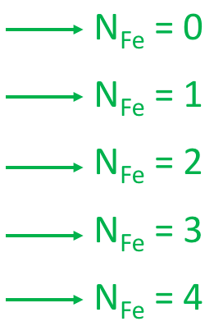
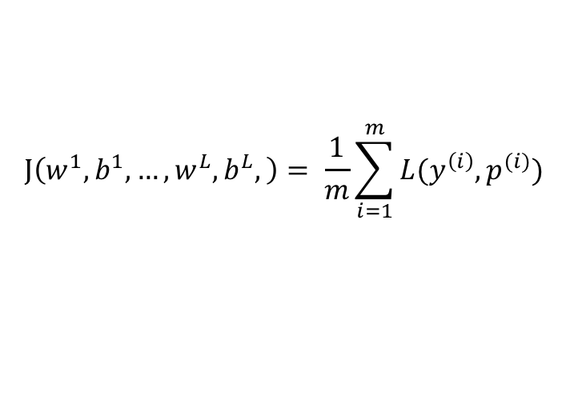
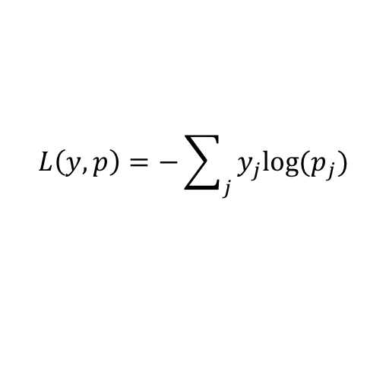
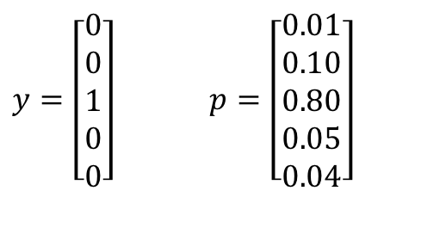
Neural Network Architecture (Multi-Class Classification)
Loss function:
$y=\left[\begin{aligned}0 \\ 0 \\ 1 \\ 0 \\ 0\end{aligned}\right]$ $p=\left[\begin{aligned}0.01 \\ 0.10 \\ 0.80 \\ 0.05 \\ 0.04\end{aligned}\right]$
$$L\left(y,p\right)=−\sum_{j}{y_{j}log⁡(p_{j})}$$
$i$-th unit of $l$-th layer
$$J\left(w^{1},b^{1},…,w^{L},b^{L},\right)= \frac{1}{m}\sum_{i=1}^{m}{L(y^{\left(i\right)}, p^{(i)})}$$
$$A_{1}^{[l−1]}$$
(1) $w_{i}^{[l]}A^{[l−1]}+b_{i}^{[l]}$ = $Z^{[l]}$
(2) $A^{\left[l\right]}=g^{[l]}$ ($Z^{[l]}$)
$$A_{i}^{[l]}$$
$$A_{2}^{[l−1]}$$
$$A_{n}^{[l−1]}$$

Slide 12
Hyperparameters to Tune
Number of hidden layers
Number of nodes in each hidden layer
Activation function of each hidden layer (ReLU or tanh)
Learning rate
With or without regularization
Optimization algorithm (Adam)
147 examples, 110 training, 37 test
TensorFlow

Slide 13
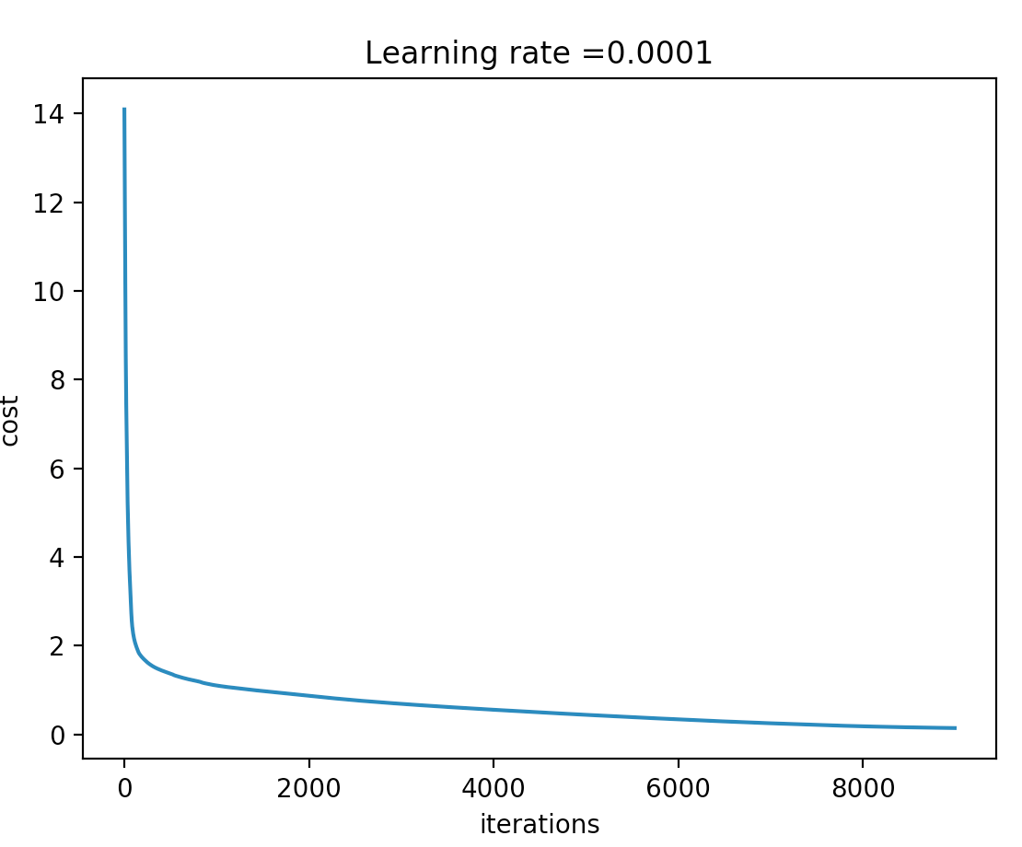
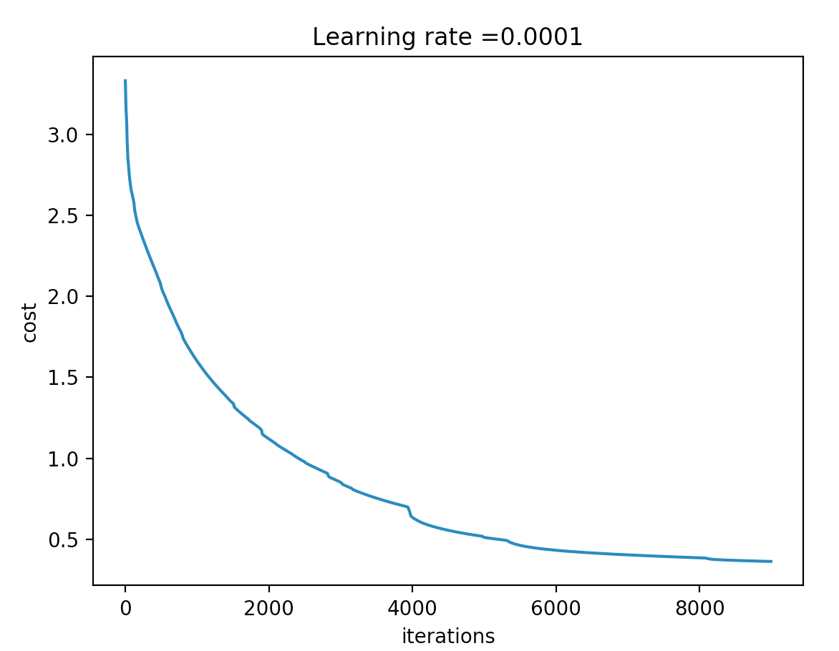
Results
ReLU + ReLU
 | w/o regularization | w/ regularization
Train accuracy | 1.00 | 1.00
Test accuracy | 0.81 | 0.86
ReLU + ReLU
overfitting
14 nodes on first hidden layer
9 nodes on second hidden layer
5 nodes on output layer
ReLU + tanh
w/ regularization
 | ReLU + ReLU | tanh + tanh | Tanh + ReLU | ReLU + tanh
Train accuracy | 1.00 | 0.99 | 0.97 | 0.96
Test accuracy | 0.86 | 0.89 | 0.89 | 0.94

Slide 14
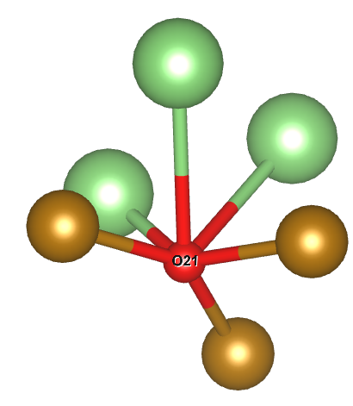
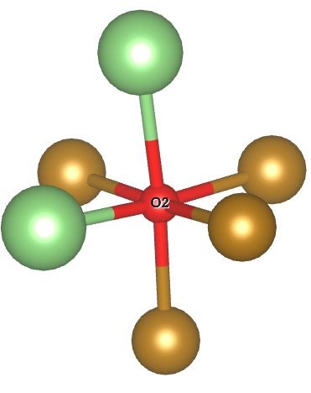
Results
number of nodes in the hidden layer:
ReLU + tanh w/ regularization
 | 14 + 9 | 12+8 | 10+8 | 7+6
Train accuracy | 0.96 | 0.99 | 0.97 | 0.96
Test accuracy | 0.94 | 0.97 | 0.89 | 0.92

Slide 15
Conclusions:
A three-layer neural network was constructed to predict the Fe coordination numbers around oxygen in Li transition metal oxide.
A training accuracy ~ 95% was achieved.
Similar NN architecture can be used in other Li-TM oxide systems.
More training examples would be desirable.

